Slide 1

NEST: Noble Element Simulation Technique
Modeling the Underlying Physics of Noble Liquids, Gases
http://nest.physics.ucdavis.edu/site/
Matthew Szydagis, UC Davis
UCLA DM 02/28/14

Slide 2
Why These Elements?
Well suited to the direct detection of dark matter
  Xenon and argon both used, in both large dark matter experiments and small-scale calibration efforts
  1- and 2-phase, and zero and non-zero field (TPCs)
Broad, compelling ν physics programs, like LBNE
  Neutrinoless double-beta decay (¹³⁶Xe): EXO, NEXT
  Coherent ν-scattering, and reactor monitoring: RED
PET scans for medical applications (511 keV γ’s)
μ⁻ => e⁻ + γ (evidence of new physics): MEG
Sensitive to nuclear recoil (NR) and electron recoils (ER) detecting photoelectrons (phe) in PMTs

Slide 3
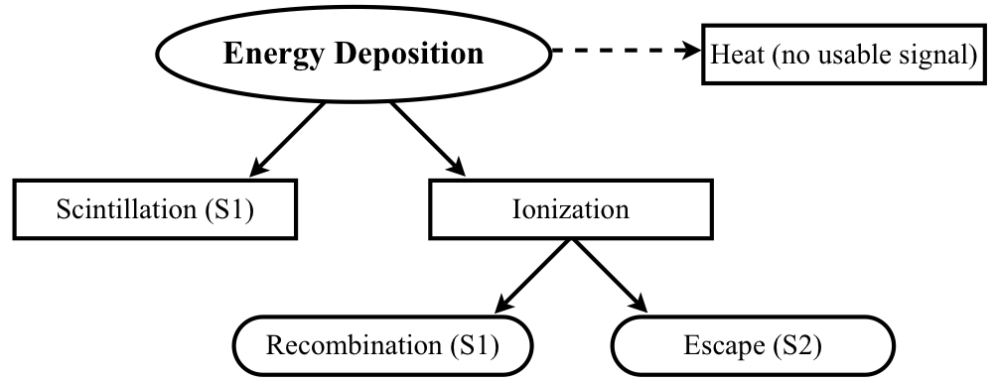
Noble Element Physics
Energy ≠ S1: energy deposited into 3 channels (“heat” prominent for NR, reducing their S1 & S2)
Excitation and recombination lead to the S1, while escaping ionization electrons lead to the S2
Divisions at each stage are functions of particle type, electric field, and dE/dx or energy
Anti-correlation: charge and light are equally important in a detector

Slide 4
Handled by NEST
Noble Element Simulation Technique is a data-driven model explaining both the scintillation and ionization yields vs. those (splines avoided)
Provides a full-fledged Monte Carlo (in Geant4) with
  Mean yields: light AND charge, and photons/electron
  Energy resolution: key in discriminating background
  Pulse shapes: S1 AND S2, including single electrons
The canon of existing experimental data was combed and all of the physics learned combined
M. Szydagis et al., JINST 8 (2013) C10003. arXiv:1307.6601
M. Szydagis et al., JINST 6 (2011) P10002. arXiv:1106.1613
J. Mock et al., JINST in press (2014). arXiv:1310.1117

Slide 5
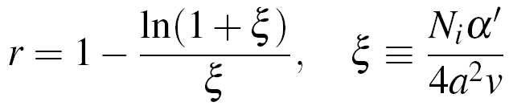
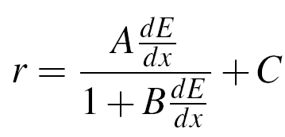
The Basic Principles
The work function for creating an S1 photon or S2 electron does not depend on the interacting particle or its energy, but differences in yields are caused by the field, energy, and particle-dependent recombination probability of ionization electrons
Recombination model is different for “short” tracks (< O(10) keV) and “long” tracks: using Thomas-Imel box (TIB) and Doke-Birks approaches, respectively
This probability is what causes non-linear yields per unit of energy. “Constants” vary with field, with Doke and TIB opposite in trend vs. total energy
TIB model uses only total energy deposited, via number of ions
By contrast, Doke-Birks relies on the energy loss

Slide 6
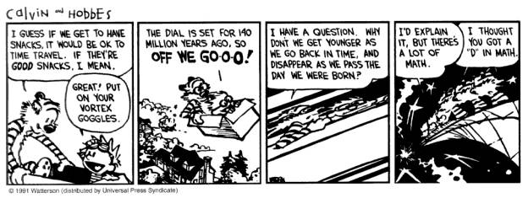
Life is Complicated
Twice the energy does not necessarily translate to twice the signal, in either channel
Long-standings ways of thinking about signals from noble-element-based detectors shattered
  In liquid Xe gamma-ray yields not flat in energy
  Field dependence of yields also energy-dependent
The NEST team dug up old, rare works, forgotten….

Slide 7
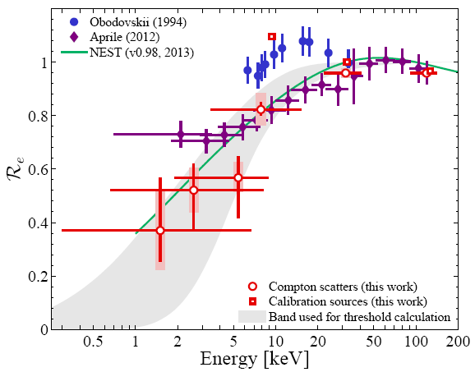
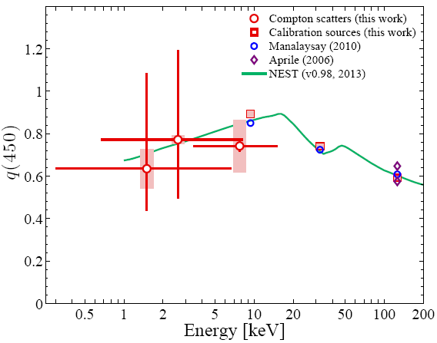
ER Scintillation Yield
Zero field
Non-zero field (450 V/cm)
Baudis et al., arXiv:1303.6891
Birks’ law at right and TIB (dE/dx-independent) for the left
Dip from K-edge (just like in NaI[Tl]). Caused here by interactions becoming multi-site in the Xe
As the energy increases dE/dx decreases, so recombination decreases: less light, at expense of more charge (Doke/Birks)
At low energy (Thomas-Imel region) recombination increases with increasing energy, leading to more scintillation per keV

Slide 8
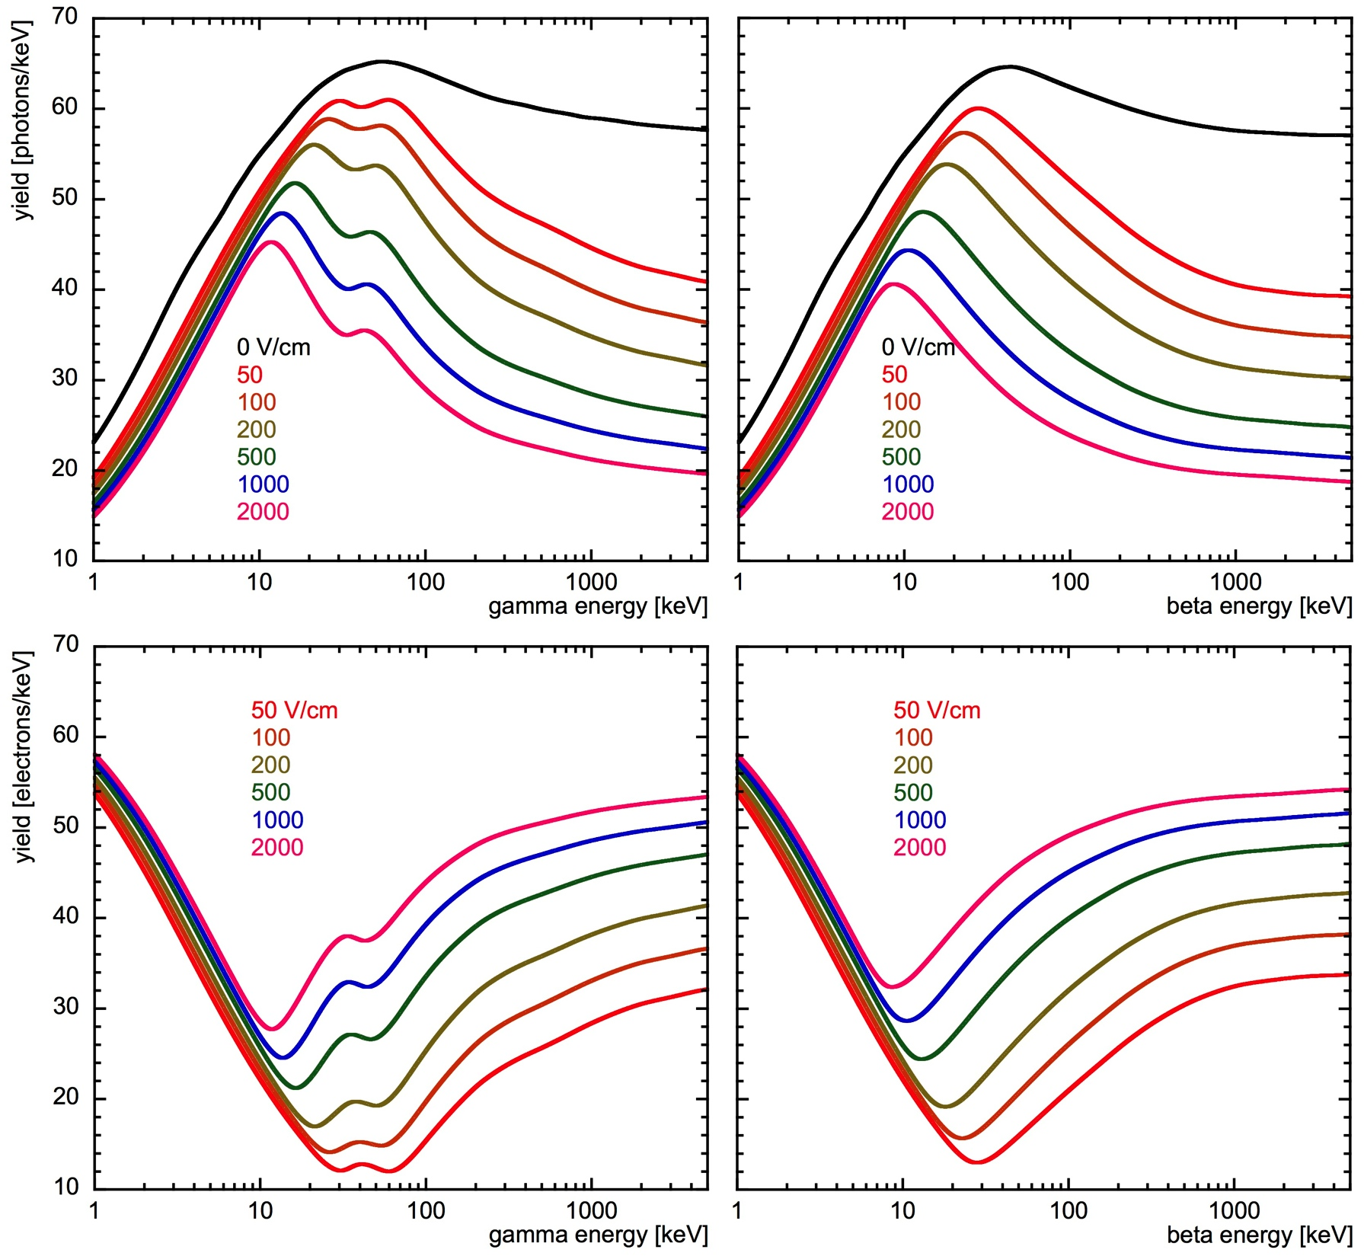
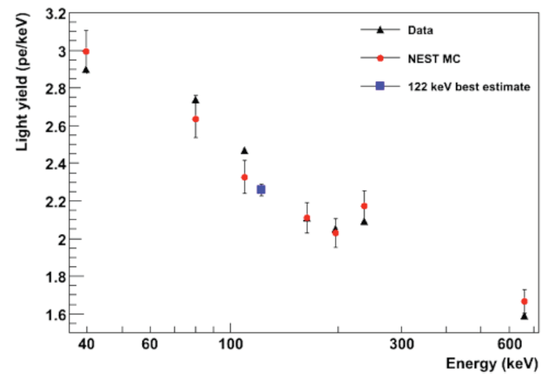
More Successful Predictions
NEST not only postdicts: it’s got predictive power for newer data!
*No* ⁵⁷Co calibration, so NEST was a key part of Xe100 WIMP limit calculation
⁵⁷Co ~122 keV, their reference point for NR light
XENON100 at 530 V/cm field
Aprile, Dark Attack 2012; Melgarejo, IDM 2012

Slide 9
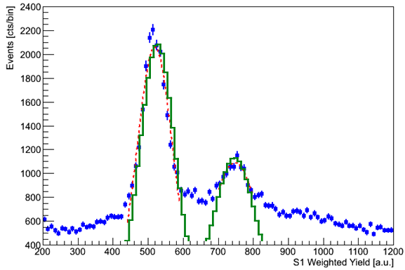
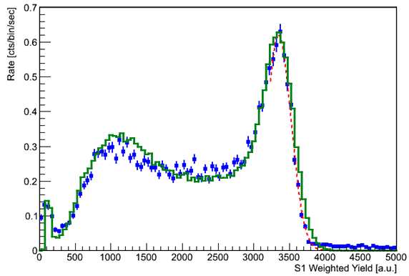
Energy Resolution: LUX
LUX surface engineering run (arXiv:1210.4569)
164 keV
236 keV (=39.6 + 196.6 keV)
LUX Surface Data
Gaussian Fits
LUXSim* + NEST
Backscatter peak ~200 keV
Fit at the same time with same model
662 keV
(¹³⁷Cs)
Peak:
30 keV x-ray..
*LUXSim paper: D.S. Akerib et al., Nucl. Inst. and Methods A 675, 63 (2011). arXiv:1111.2074
May be the first time that Monte Carlo peak width is not informed by the data!
M. Woods

Slide 10
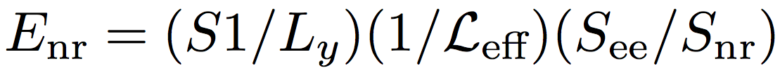


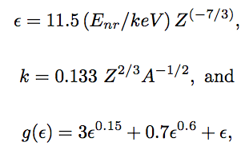
NEST-Based Energy Scale
L and L_{eff} are NOT the same
W_{LXe} = 13.7 +/- 0.2 eV
Energy a linear combination of the number of primary photons n_{γ} and electrons n_{e} generated
Photon count equal to S1 phe (XYZ-corrected with calibration events) divided by detection efficiency (light collection x PMT QE), and electron count is S2 phe (XYZ-corrected) divided by the product of extraction efficiency and the number of phe per e⁻
Scale calibrated using ER (L=1). Hitachi-corrected* Lindhard factor assumed for NR (k=0.11 not 0.166)
Matches LUX data, and others’ measurements
* P. Sorensen and C.E. Dahl, Phys. Rev D 83 (2011) 063501, [arXiv:1101.6080]

Slide 11
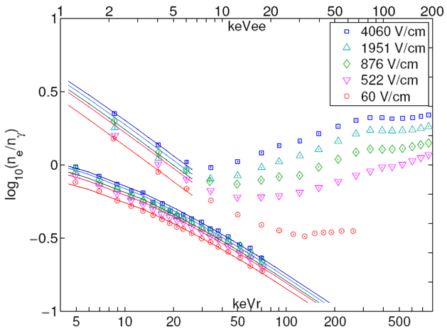
Clearing the Air on the Myths
Data presented in terms of log(n_{e}/n_{γ}), converted from log(S2/S1), but keVee scale is (n_{e}+n_{γ})*13.7 eV and so can easily extract n_{γ} and n_{e} alone and get their field dependencies
AmBe and ²⁵²Cf sources, not an angle-tagged neutron scattering measurement, but important thing is *relative* yield is well established
Approximate analysis region for LUX here
ER (above)
NEST (lines)
(high-energy Doke-Birks regime not plotted, only TIB)
NR (below)
Dahl 2009
The keVnr energy scale shown here is Dahl’s, and assumes an old, flat L = 0.25: using Hitachi, the 5 keVnr point is actually 8.67 and the 70 keVnr point is 85.5 (and this correction has been accounted for in NEST when fitting the data). The keVee scale is still correct.
Notes:
Just scratching the surface on the myths

Slide 12
MYTH: NEST is based on the Manzur et al. 2010 NR light and charge yield data. False: NEST based on Dahl. (So much for “garbage in, garbage out”). Uses nearly same parameters for ER and for NR!
MYTH: The field dependence of the NR light (and charge) yield in LXe has not been (well) measured. False: Conclusively demonstrated to be small (<10% across energy from 60 to 4,000 V/cm!) by Dahl, supplemented by Manzur 2010, Aprile 2006.
  Until SCENE, *no* measurement of this in existence for Ar: In general, much easier to find data on Xe
  Charge yield just measured at LLNL: hot off presses
MYTH: LXe field dependence for NR mysteriously worse than in LAr. False: Comparable, possibly even smaller, and less energy-dependent. Measured.

Slide 13
Eric Dahl, 2009 Princeton Ph.D., Fig. 5.4
E=4.06 kV/cm
E=1.951 kV/cm
ER
ER
NR
NR
E=0.522 kV/cm
E=0.060 kV/cm
ER
ER
NR
NR

Slide 14
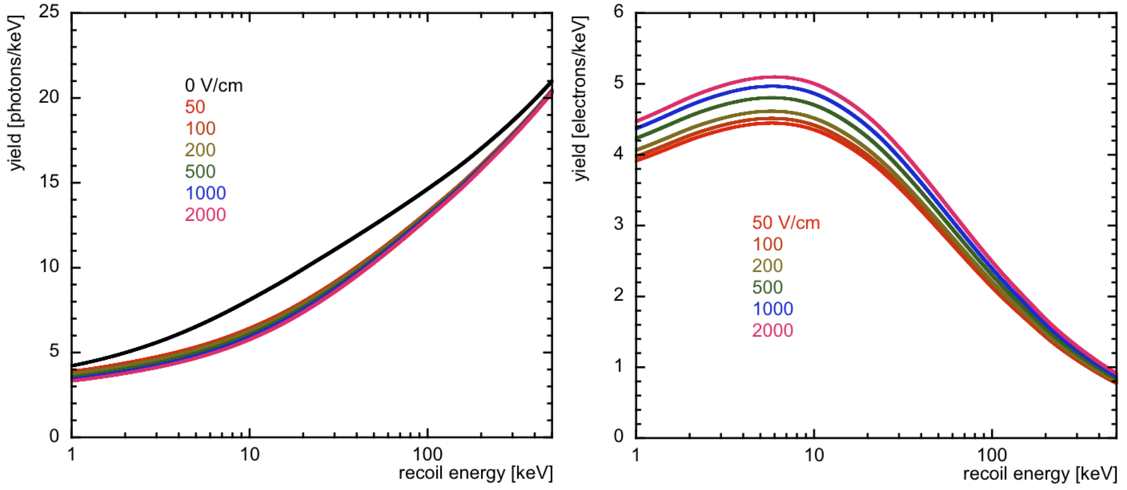
Electric Field Dependence
Steep drop from null to non-zero field (then slow change) is needed to simultaneously explain both Dahl thesis data AND zero field too, assuming same L-factor
  OR, Manzur not Plante at 0 V/cm
NEST is conservative, but more importantly, self-consistent
Post-dictions based on fits to Dahl, so agreement with Manzur a pleasant consequence
Curves are all tightly constrained: quanta sum fixed by Hitachi, while Dahl gives us the ratio of the types (electrons to photons)
See J. Verbus’ talk for comparison with data
Turnover caused by battle between decreasing L and increasing (1– r)

Slide 15

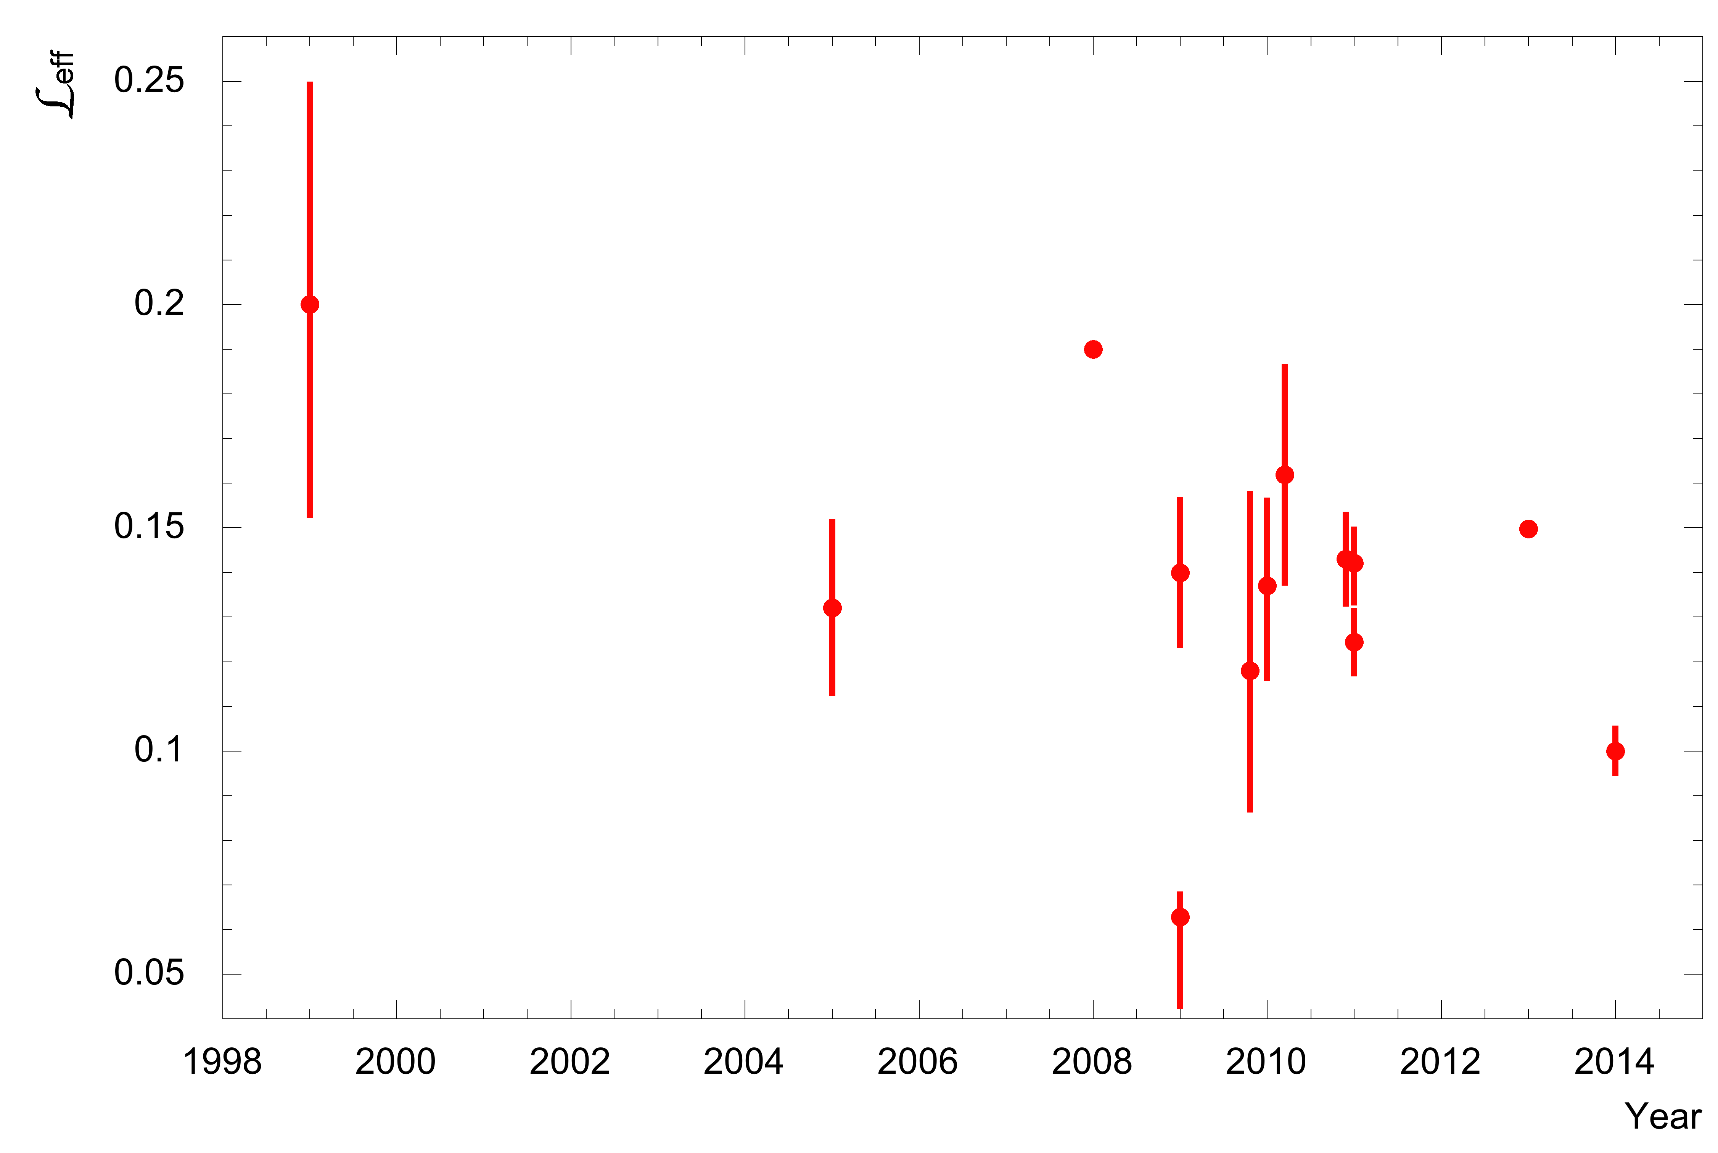
The Myth of An Incredible Shrinking NR Light Yield?
Example: 10 keVnr claimed scintillation yield vs. time (example chosen to be low energy but with ample data)
Does this look like it is mutating unreasonably (given the error bars) or decreasing monotonically? NO.
No need to use Co-57 reference anymore (can’t penetrate modern large detectors anyway) but is traditional
A mistake, it’s simple as that. Understood, and retracted by the ZEPLIN-III collaboration…
LUX DD gun: 181 V/cm, uncorrected (probably comes up by ~10-20%).
Xe100 too high myth is plausible (just smidgen)
Notes:
I did not pick 10 keVnr to cheat! Looks to me like convergence upon the truth

Slide 16
MYTH: Continuous-energy neutron sources (AmBe, Cf-252) not valid for calibration. Energy resolution hides misunderstandings. Need mono-energetic source like Y-88/Be. False: DD result consistent with NEST, and consistent with AmBe, etc. data
MYTH: Extrapolation from the results of smaller detectors is not valid. False: DD data in situ (LUX) agrees with earlier dedicated measurements
MYTH: There is some kind of “kinematic cut-off” which creates a zero-yield situation. Implausible: Empirically, the idea is due to a misunderstanding of earlier data, and has weak theoretical basis: nobles not like other scintillators -- recombination

Slide 17
The Fano Factor Myth
Fano factor <<1 hence can’t capitalize on finite energy resolution at low energies to give you “sub-threshold fluctuations” and improve your limit?
Even if this is true for fundamental quanta (not necessarily: NEST has two “Fano factors,” one for total quanta that is 0.03, and one O(10-100) representing recombination fluctuations), the finite light collection efficiency of noble detectors implies binomial or Poissonian statistics
  Look at the numbers: ~8.4 phe/keVee (LUX zero-field, 662 keV) implies 8/(60 photons/keV) = 0.14, which makes sense when modeled (QE x geometric effects); 8 phe/keVee (DarkSide) -> 8/40 = 0.20
  S1 photon detection efficiency always O(10)%

Slide 18
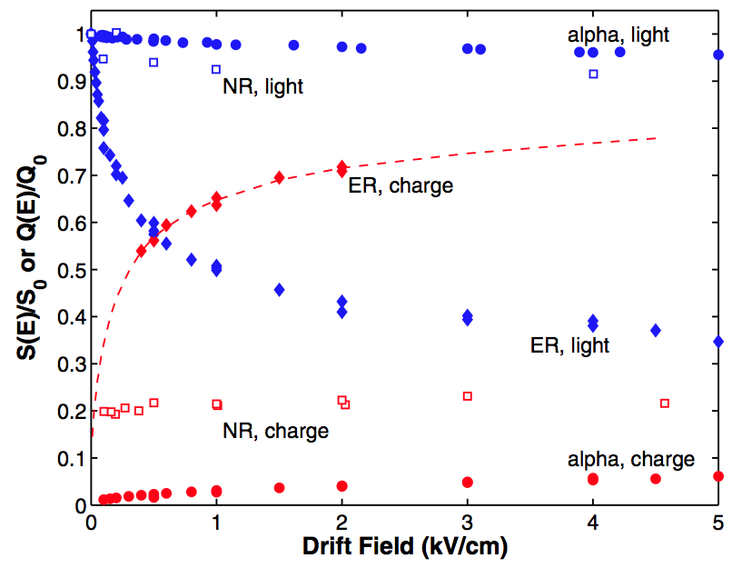
Oversimplification
Aprile et al. 2006
These curves are for Co-57 (122 keV). Are they really generic for electron recoils?
(but to be fair, understanding has evolved since 2006)
NO.

Slide 19
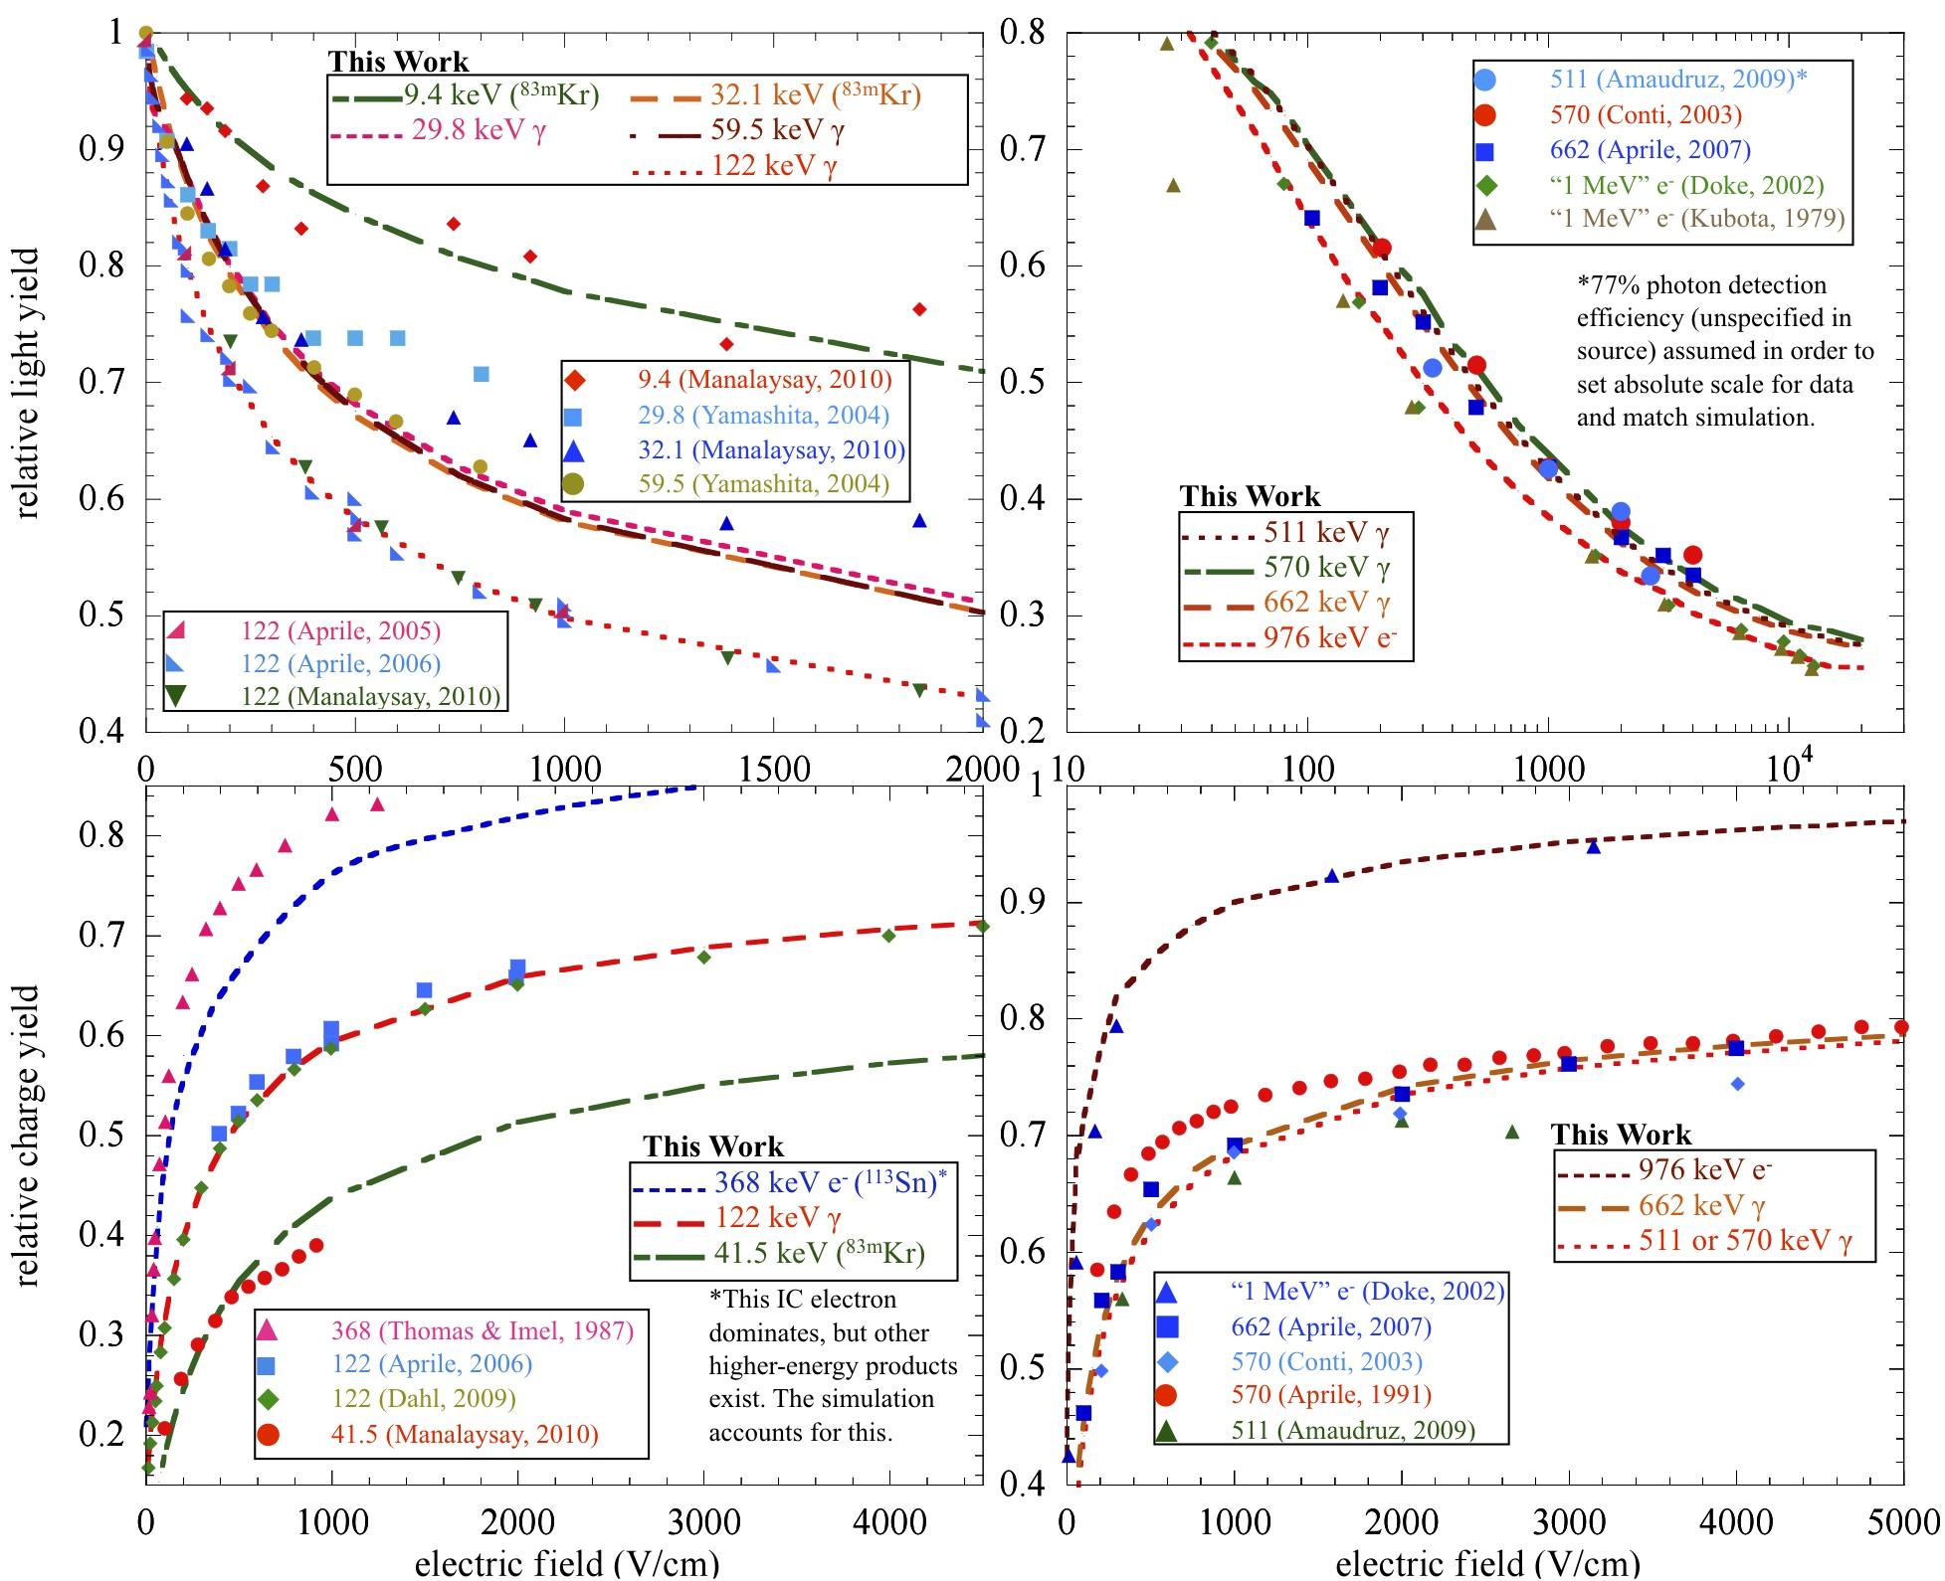
19

Slide 20
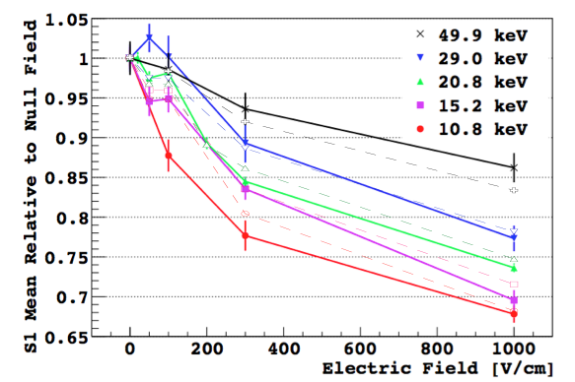
Can NEST do Argon?
Few “free” parameters
NEST as hollow points and dashed lines (same colors)
PRELIMINARY
Perfect? No, but this was a first stab..
See talk by SCENE collaboration

Slide 21
SUMMARY
Simulation model and code NEST has a firm grasp of the microphysics relevant for liquid nobles
Though NEST does not track individual atoms or excimers, it is close to first principles, considering the excitation, ionization, and recombination physics, resorting to empirical interpolations as indirect fits
Extensive empirical verification against past data undertaken using multiple works, but focus on Dahl.
Liquid xenon is essentially finished, but there is still work being done for liquid argon
User-editable code for the entire community
Our understanding of the microphysics is only as good as the best data. Models are beautiful but nature is tricky. NEST is constantly improving
Many criticisms of NEST, particularly when it comes to xenon, evaporate when confronted with the FACTS.

Slide 22
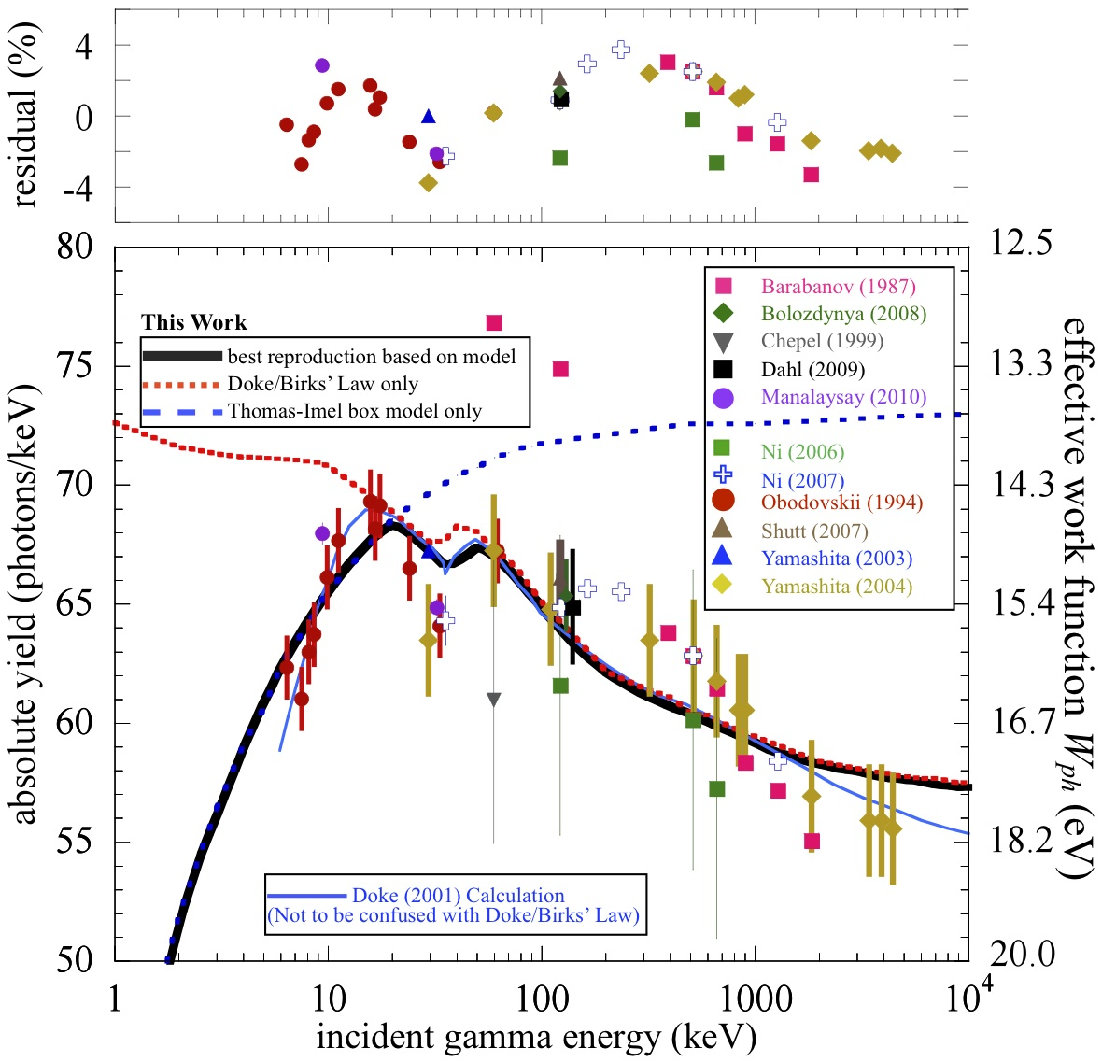

Slide 23
The Recombination Fluctuations

Slide 24
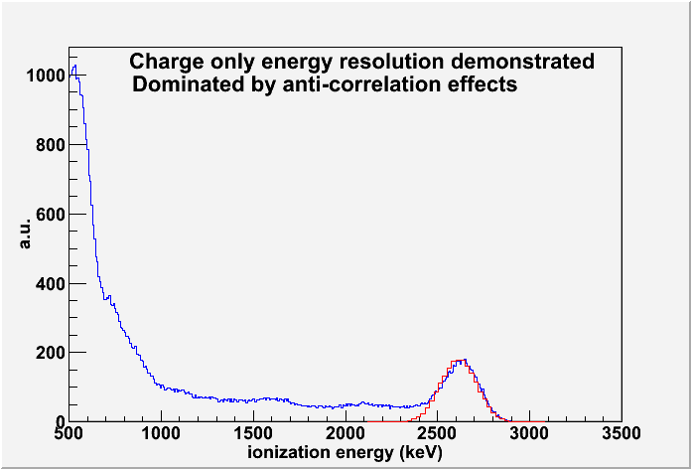
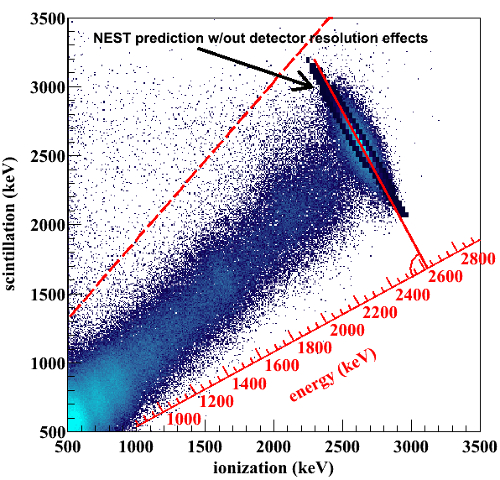
Energy Resolution: EXO
(not simulating the full BG spectrum).
EXO
Prediction for a field never studied before (376 V/cm) and a new energy (2.6 MeV gammas, whereas NEST vetted at 0.57)
The recombination fluctuations modeled as worse than binomial with a field-dependent Fano-like factor (big)
P.S. Barbeau

Slide 25
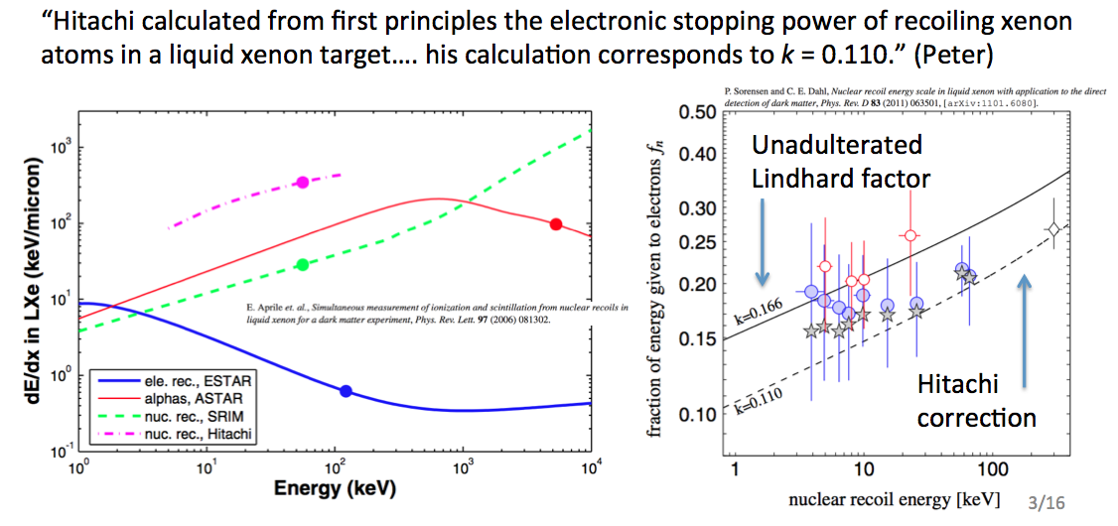

Slide 26
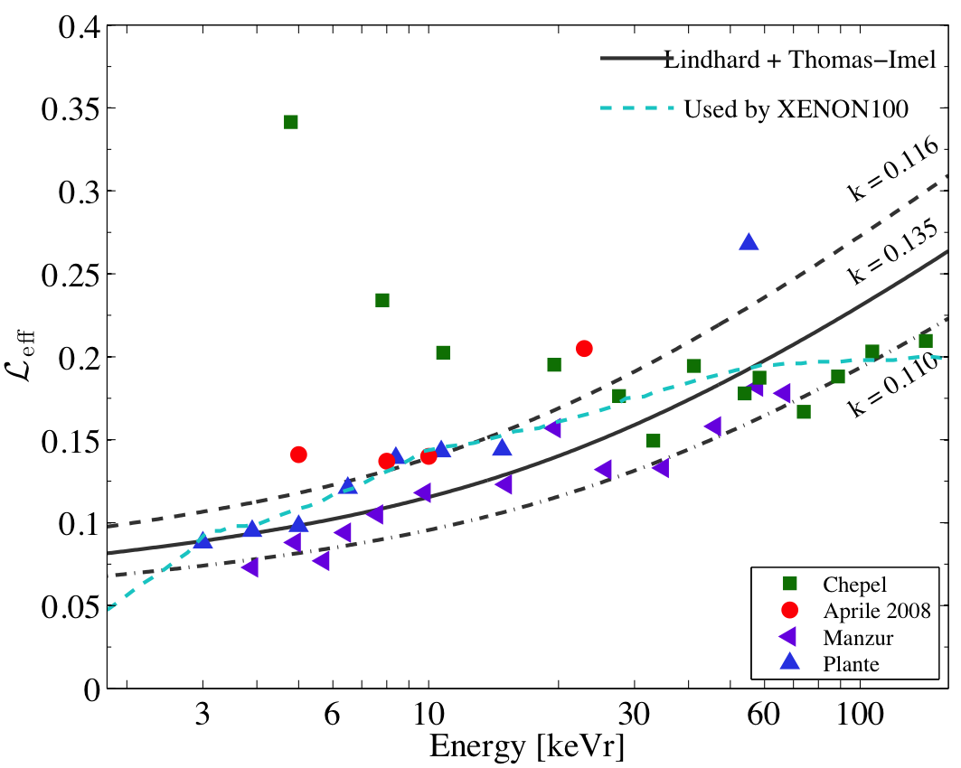
Variation in L Factor
k = 0.166
A. Manalaysay

Slide 27
NR Scintillation Yield

Slide 28
NR Ionization Yield
3.0 keVnr cut-off as with scintillation (LUX)
XENON100 (730 V/cm)
LUX (181 V/cm)

Slide 29
dotted lines for Hitachi, solid for Lindhard
NEST
NEST
NEST
NEST

Slide 30
NR Band in LUX
Both single-scatter (WIMP-like) and full AmBe simulations use NEST, but AmBe sim includes ER component (Compton scatters) + neutron-X event (multiple-scatter, single-ionization) contamination
Mean
of NR band from LUX data
Neutron-only effects shifting band mean and width in well-understood fashion, inapplicable to WIMP scattering. When they’re included, there’s agreement with data
Width

Slide 31
Agreement with Past
Band width and band mean for NR post-dicted for the old XENON10 data, after model construction based on Dahl, whose data are extensive in both field and energy, and who was the first to use a combined energy scale at low energies. In addition, he estimated intrinsic energy resolution, subtracting out the detector effects

Slide 32
ZEPLIN-III Band Width

Slide 33
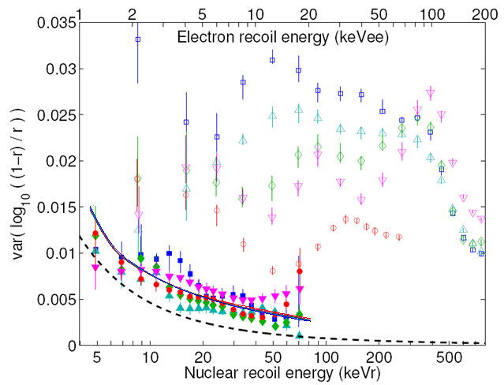
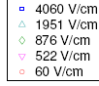
Band Width Model
Number of e⁻’s was varied as √ (F_{e} n_{e}) per interaction site
Averaged over field (negligible evidence of electric field dependence) and found an increasing ionization Fano-like factor describes the data well (just like it does in case of ER)
Rejected options of vanilla Fano and L factor fluctuations because no effect on band width seen
Ignore hollow (ER) points. NR is solid
Dahl 2009
NEST (same fields)
Assuming only binomial fluctuations
Y-axis is an analogue for the log10(S2/S1) width

Slide 34
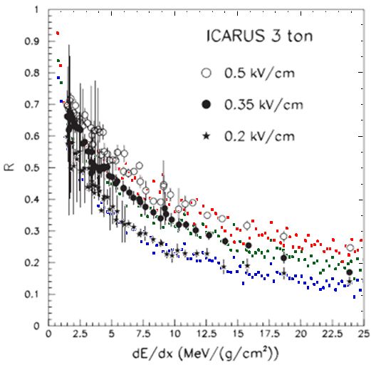
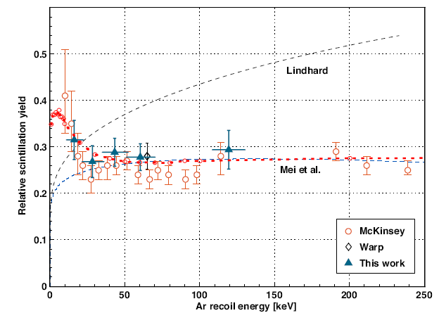
Teaser for Argon
Scintillation yield relative to ER is higher in Ar than in Xe
Evidence of possible Ar-Ar cross-section enhancement
NEST
500 V/cm
350
200
R=1–r is a way of checking both light and charge yields, concurrently
Regenfus et al., arXiv:1203.0849
Turn-up explained with Bezrukov et al.
Amoruso et al., NIM A 523 (2004) pp. 275–286
NEST (red dash)

